Slide 1
Galway Buy & Sell
Professional I.T. Skills Project
By Raja and Waheed

Slide 2
Why We Made This Website
People all the Time Searching/Selling stuff online.
Easy to use and maintain.
very basic technology used to build.

Slide 3
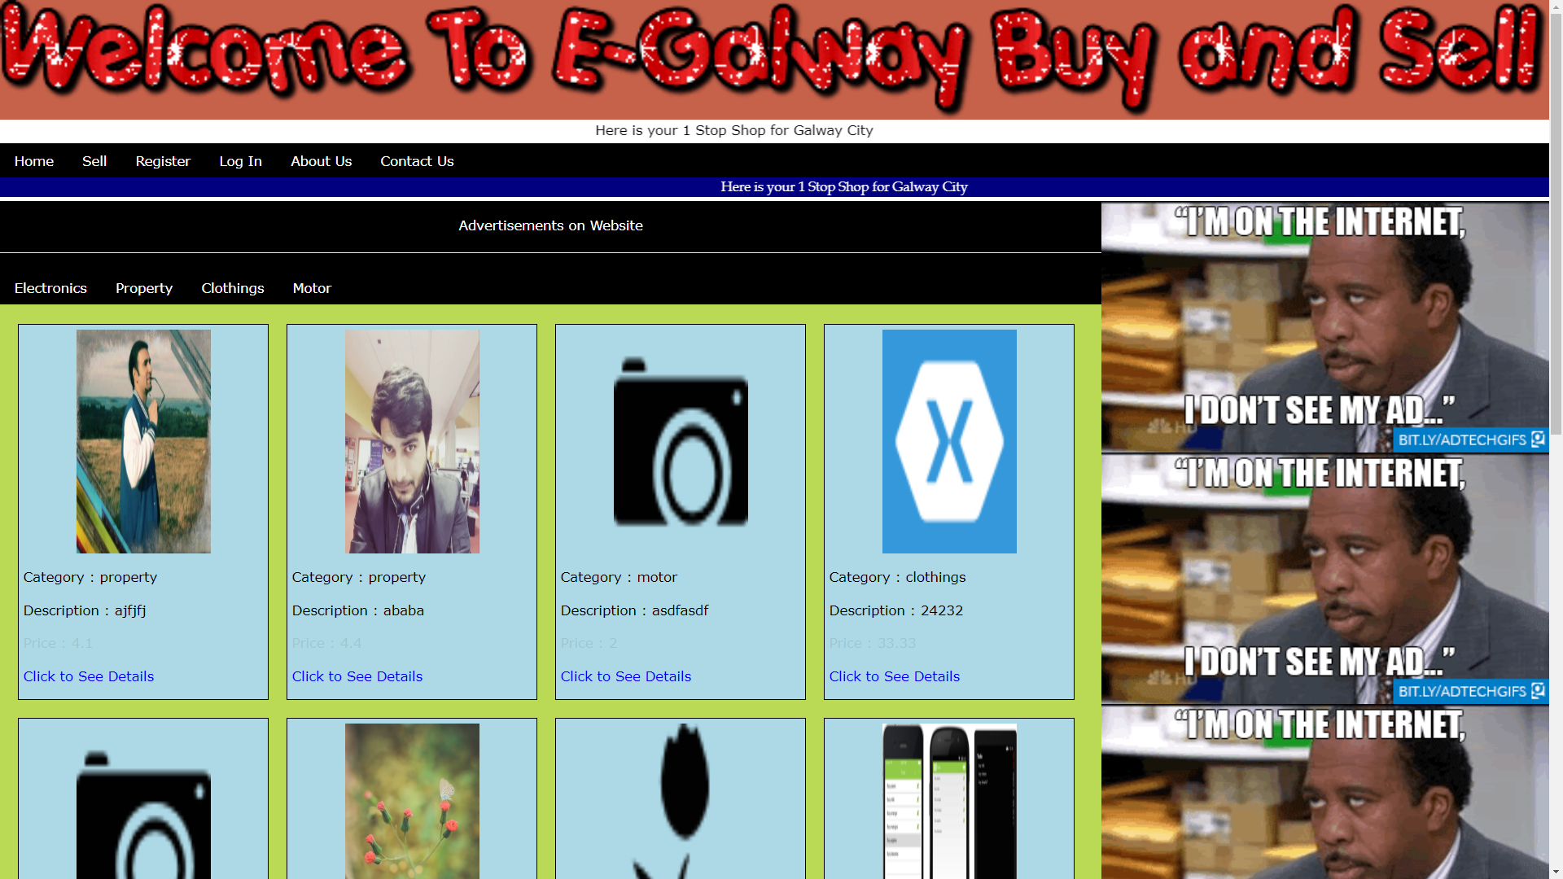
Galway Buy Sell

Slide 4
Technology Used to Build:
H.T.M.L
MySQL
P.H.P.
C.S.S.

Slide 5
Any Questions ?

